Slide 1
Tema: Organización física de la computadora (Hardware)
Alumnos: Abrego, David Stefano; Fernández, Juan Bautista; Salim Taleb, Nasim Anibal.

Slide 2
Actividad 1: Procesamiento de datos mediante computadoras
 | Entradas |  |  |  | Salidas
N° | A | B | C | D | a | b | c | d | e | f | g | h | u | p
0 | 0 | 0 | 0 | 0 | 1 | 1 | 1 | 1 | 1 | 1 | 1 | 1 | 0 | 0
1 | 0 | 0 | 0 | 1 | 0 | 0 | 1 | 1 | 0 | 0 | 0 | 0 | 0 | 0
2 | 0 | 0 | 1 | 0 | 1 | 1 | 1 | 0 | 1 | 1 | 1 | 0 | 1 | 1
3 | 0 | 0 | 1 | 1 | 1 | 1 | 1 | 1 | 1 | 1 | 0 | 0 | 1 | 1
4 | 0 | 1 | 0 | 0 | 0 | 0 | 1 | 1 | 0 | 0 | 0 | 1 | 1 | 1
5 | 0 | 1 | 0 | 1 | 1 | 1 | 0 | 1 | 1 | 1 | 0 | 1 | 1 | 1
6 | 0 | 1 | 1 | 0 | 1 | 1 | 0 | 1 | 1 | 1 | 1 | 1 | 1 | 1
7 | 0 | 1 | 1 | 1 | 1 | 1 | 1 | 1 | 0 | 0 | 0 | 0 | 0 | 0
8 | 1 | 0 | 0 | 0 | 1 | 1 | 1 | 1 | 1 | 1 | 1 | 1 | 1 | 1
9 | 1 | 0 | 0 | 1 | 1 | 1 | 1 | 1 | 0 | 0 | 0 | 1 | 1 | 1

Slide 3

Mapas de karnaugh (segmento a-b) $$F=\overline{B}\overline{D}+C+A+BD$$
AB CD | 00 | 01 | 11 | 10
00 | 1 | 0 | X | 1
01 | 0 | 1 | X | 1
11 | 1 | 1 | X | X
10 | 1 | 1 | X | X

Slide 4

Segmento C $$F=\overline{B}+\overline{C}\overline{D}+CD$$
AB CD | 00 | 01 | 11 | 10
00 | 1 | 1 | X | 1
01 | 1 | 0 | X | 1
11 | 1 | 1 | X | X
10 | 1 | 0 | X | X

Slide 5

Segmento d $$F=\overline{C}+D+B$$
AB CD | 00 | 01 | 11 | 10
00 | 1 | 1 | X | 1
01 | 1 | 1 | X | 1
11 | 1 | 1 | X | X
10 | 0 | 1 | X | X

Slide 6

Segmento e-f $$F=\overline{B}\overline{D}+C\overline{D}+\overline{B}C+B\overline{C}D$$
AB CD | 00 | 01 | 11 | 10
00 | 1 | 0 | X | 1
01 | 0 | 1 | X | 0
11 | 1 | 0 | X | X
10 | 1 | 1 | X | X

Slide 7

Segmento g $$F=\overline{B}\overline{D}+C\overline{D}$$
AB CD | 00 | 01 | 11 | 10
00 | 1 | 0 | X | 1
01 | 0 | 0 | X | 0
11 | 0 | 0 | X | X
10 | 1 | 1 | X | X

Slide 8

AB CD | 00 | 01 | 11 | 10
00 | 1 | 1 | X | 1
01 | 0 | 1 | X | 1
11 | 0 | 0 | X | X
10 | 0 | 1 | X | X

Slide 9

Segmento U-p $$F=A+C\overline{D}+\overline{B}C+B\overline{C}$$
AB CD | 00 | 01 | 11 | 10
00 | 0 | 1 | X | 1
01 | 0 | 1 | X | 1
11 | 1 | 0 | X | X
10 | 1 | 1 | X | X

Slide 10
Codificación en código ascii de letras mayúsculas y minúsculas
MAYÚSCULAS |  |  |  |  |  | MINÚSCULAS
A | 65 | J | 74 | S | 83 | a | 97 | j | 106 | s | 115
B | 66 | K | 75 | T | 84 | b | 98 | k | 107 | t | 116
C | 67 | L | 76 | U | 85 | c | 99 | l | 108 | u | 117
D | 68 | M | 77 | V | 86 | d | 100 | m | 109 | v | 118
E | 69 | N | 78 | W | 87 | e | 101 | n | 110 | w | 119
F | 70 | O | 79 | X | 88 | f | 102 | o | 111 | x | 120
G | 71 | P | 80 | Y | 89 | g | 103 | p | 112 | y | 121
H | 72 | Q | 81 | Z | 90 | h | 104 | q | 113 | z | 122
I | 73 | R | 82 |  |  | i | 105 | r | 114

Slide 11
Codificación propuesta
Carácter | Decimal | Hex | Binario
(espacio) | 0 | 0 | 000000
A | 1 | 1 | 000001
B | 2 | 2 | 000010
C | 3 | 3 | 000011
D | 4 | 4 | 000100
E | 5 | 5 | 000101
F | 6 | 6 | 000110
G | 7 | 7 | 000111
H | 8 | 8 | 001000
I | 9 | 9 | 001001
J | 10 | A | 001010
K | 11 | B | 001011
L | 12 | C | 001100
M | 13 | D | 001101
N | 14 | E | 001110
O | 15 | F | 001111
P | 16 | 10 | 010000
Q | 17 | 11 | 010001

Slide 12
Codificación propuesta
Carácter | Decimal | Hex | Binario
R | 18 | 12 | 010010
S | 19 | 13 | 010011
T | 20 | 14 | 010100
U | 21 | 15 | 010101
V | 22 | 16 | 010110
W | 23 | 17 | 010111
X | 24 | 18 | 011000
Y | 25 | 19 | 011001
Z | 26 | 1A | 011010
a | 27 | 1B | 011011
b | 28 | 1C | 011100
c | 29 | 1D | 011101
d | 30 | 1E | 011110
e | 31 | 1F | 011111
f | 32 | 20 | 100000
g | 33 | 21 | 100001
h | 34 | 22 | 100010

Slide 13
Codificación propuesta
i | 35 | 23 | 100011
j | 36 | 24 | 100100
k | 37 | 25 | 100101
l | 38 | 26 | 100110
m | 39 | 27 | 100111
n | 40 | 28 | 101000
o | 41 | 29 | 101001
p | 42 | 2A | 101010
q | 43 | 2B | 101011
r | 44 | 2C | 101100
s | 45 | 2D | 101101
t | 46 | 2E | 101110
u | 47 | 2F | 101111
v | 48 | 30 | 110000
w | 49 | 31 | 110001
x | 50 | 32 | 110010
y | 51 | 33 | 110011
z | 52 | 34 | 110100

Slide 14
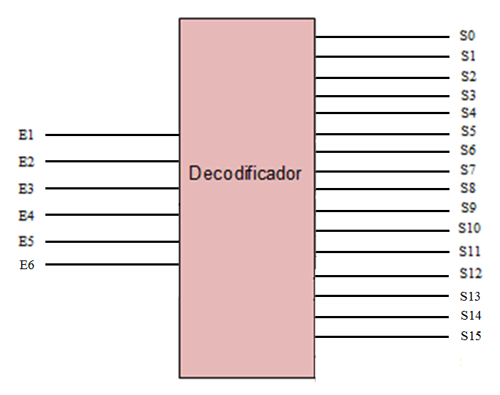
Decodificador para el display

Slide 15
La palabra a mostrar es “computadora”
 | Entradas |  |  |  |  |  | Salidas
Letra | A | B | C | D | E | F | a | b | c | d | e | f | g | h | k | m | n | u | p | t | s | r
C | 0 | 0 | 0 | 0 | 1 | 1 | 1 | 1 | 0 | 0 | 1 | 1 | 1 | 1 | 0 | 0 | 0 | 0 | 0 | 0 | 0 | 0
O | 0 | 0 | 1 | 1 | 1 | 1 | 1 | 1 | 1 | 1 | 1 | 1 | 1 | 1 | 0 | 0 | 0 | 0 | 0 | 0 | 0 | 0
M | 0 | 0 | 1 | 1 | 0 | 1 | 0 | 0 | 1 | 1 | 0 | 0 | 1 | 1 | 1 | 0 | 1 | 0 | 0 | 0 | 0 | 0
P | 0 | 1 | 0 | 0 | 0 | 0 | 1 | 1 | 1 | 0 | 0 | 0 | 1 | 1 | 0 | 0 | 0 | 1 | 1 | 0 | 0 | 0
U | 0 | 1 | 0 | 1 | 0 | 1 | 0 | 0 | 1 | 1 | 1 | 1 | 1 | 1 | 0 | 0 | 0 | 0 | 0 | 0 | 0 | 0
T | 0 | 1 | 0 | 1 | 0 | 0 | 1 | 1 | 0 | 0 | 0 | 0 | 0 | 0 | 0 | 1 | 0 | 0 | 0 | 0 | 1 | 0
A | 0 | 0 | 0 | 0 | 0 | 1 | 1 | 1 | 1 | 1 | 0 | 0 | 1 | 1 | 0 | 0 | 0 | 0 | 0 | 0 | 0 | 0
D | 0 | 0 | 0 | 1 | 0 | 0 | 1 | 1 | 1 | 1 | 1 | 1 | 0 | 0 | 0 | 1 | 0 | 0 | 0 | 0 | 1 | 0
R | 0 | 1 | 0 | 0 | 1 | 0 | 1 | 1 | 1 | 0 | 0 | 0 | 1 | 1 | 0 | 0 | 0 | 1 | 1 | 0 | 0 | 1

Slide 16
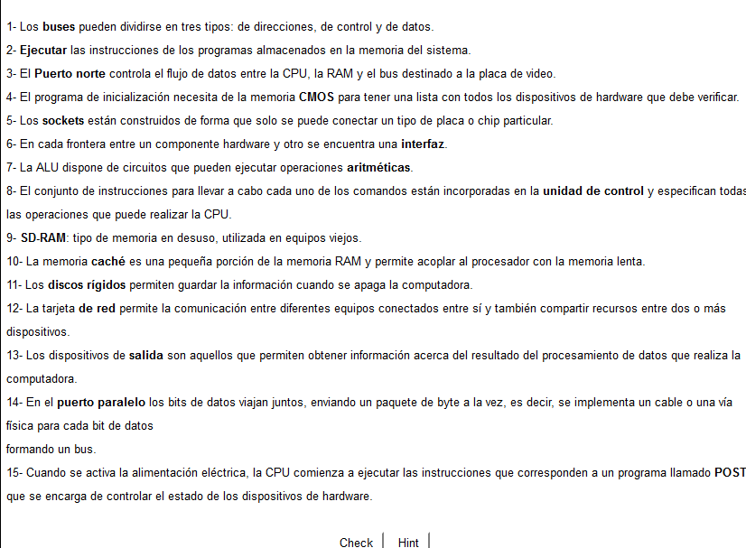
Ejercicio Proporcionado

Slide 17
Escena actividad N°3
Steve Jobs
Steve Wozniak
Homebrew Computer Club, Universidad de Stanford
Primera computadora

Slide 18
Componentes que observamos en la escena
Terminal de computadora
Teclado
Televisor o monitor
Altair (8800)
Memoria RAM
Microprocesador

Slide 19
Bibliografía
https://www.clarin.com/tecnologia/Steve-Jobs-trayectoria-creativo-limites_0_BJiQQ1R3vQl.html
http://www.woz.org/about/
https://www.youtube.com/watch?v=QjpRrDtxFdY
https://youtu.be/-I_xFYB2E0w
https://es.scribd.com/doc/247998934/Decodificador-BCD-a-7-segmentos-pdf
https://web.archive.org/web/20090119074634/http://www.old-computers.com/museum/computer.asp?c=62&st=1

